Slide 1



CASE STUDY GOLD PRICE PREDICTION
Symbiosis Institute of
Technology, Nagpur
By-
Chinmay Gandhewar
Shreyas Kasture
Ruthvek Kannan
Mahati Akella
22070521170
22070521032
22070521031
22070521027

Slide 2

Problem Statement
Brief Overview:
The "Gold Price Prediction" project aims to develop a model that can accurately predict the prices of gold based on various factors. This prediction task is of great significance in the financial sector, enabling investors and traders to make informed decisions. By employing machine learning algorithms and a curated dataset, this project offers a valuable tool for estimating gold prices.
Key Objectives:
Data Collection and Processing
Data Visualization
Train-Test Split
Regression Model using Random Forest
Model Evaluation

Slide 3
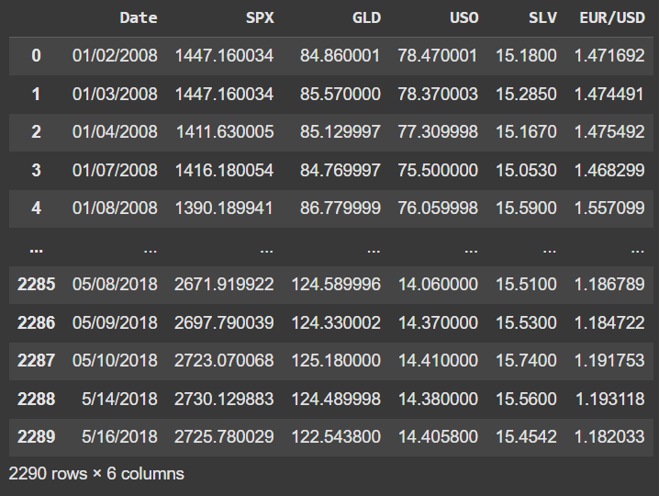
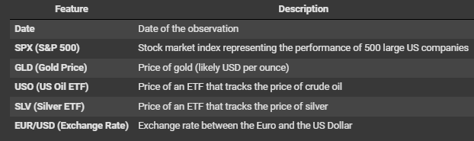
Dataset Overview
Dataset Description:
The data was sourced from the kaggle website consisting of ten years data from January 2008 to Decmeber 2018. It consists of the variables date, silver price, stock profit exchange, gold price ,US dollar rate and united states oil ETF. The dataset consists of 2290 records.
Since gold is stored and accumulated over years, the influence of an year’s production on its price is less. The price of gold depends on currency fluctuations and other economic variables.

Slide 4
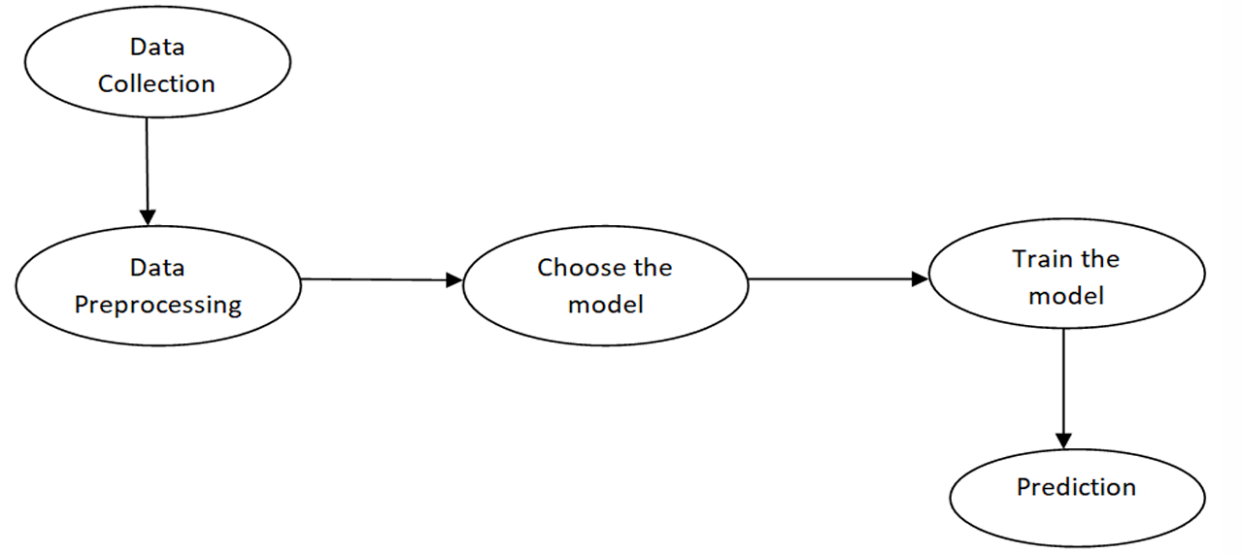
Methodology
Approach:
To predict the gold price, we need to build a machine learning model which includes the following steps.

Slide 5
Implementation
1. Data Collection:
The first thing required while building a machine learning model is the data. The data is collected from kaggle
website consisting of 2290 records and 6 attributes.
2. Data Preprocessing:
Data preprocessing is required when the data is incomplete, inconsistent or noisy. The data collected was noisy, so
we performed outlier analysis and removed the noisy data. The data transformation is also done by performing
normalization in which the data in each attribute is scaled between the range 0 to 1.
3.Choose the model:
Prediction of gold price is a regression task, so we consider the regression algorithms such as Multiple Linear
Regression, Random Forest Regressor and Gradient Boosting for building the model.
4. Training the model:
The model is trained by importing the required model and by passing the training data to it. The dataset is splitted into train and test data with test_size=0.20. The linear model is imported from sklearn and the Random forest regressor and Gradient boosting regressor modules are imported from sklearn.ensemble. These models are trained by passing the train data.
5. Prediction:
The trained model is checked by predicting the test data of the dependent variable using the test data of the independent variables.

Slide 6
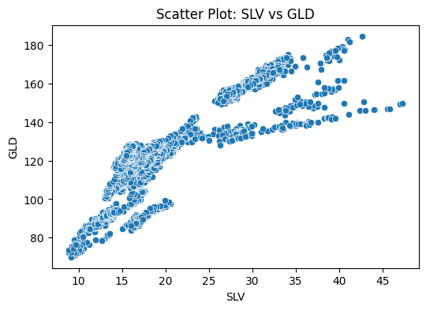
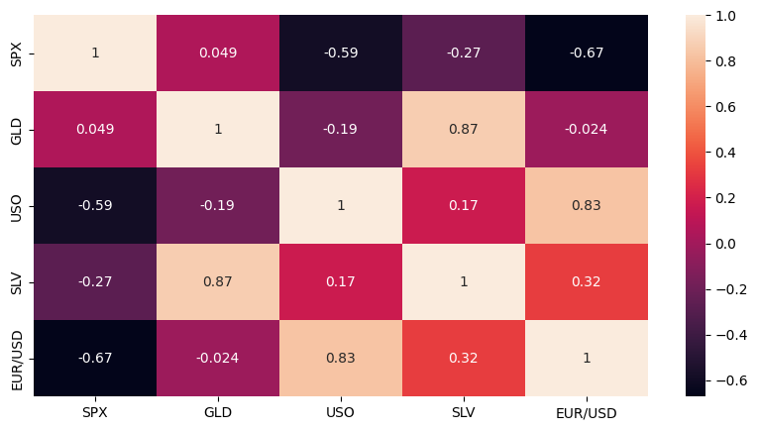
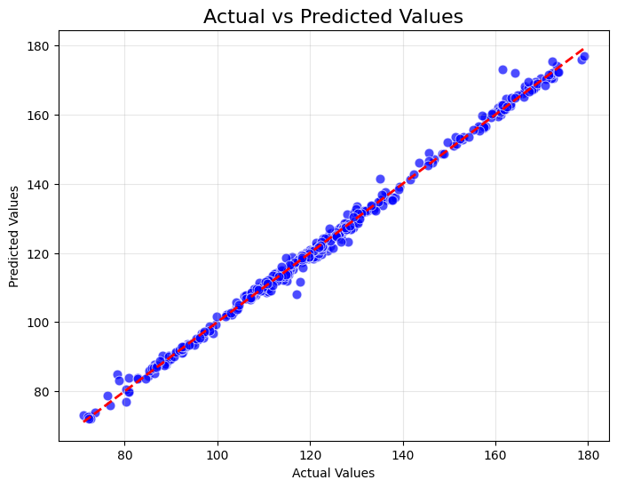
Data Visualization
There's a clear positive correlation, confirming the 0.87 correlation we saw in the matrix
The relationship appears to be roughly linear but with some distinct clusters
The price ranges show GLD varying from about 80 to 180
Multiple price regimes are visible, suggesting different market conditions or time periods
GLD (Gold ETF) has a very strong positive correlation (0.87) with SLV (Silver ETF), which makes sense as gold and silver often move together.
SPX (S&P 500) has negative correlations with most other instruments, particularly strong negative correlation with EUR/USD (-0.67).
USO (Oil ETF) shows a strong positive correlation with EUR/USD (0.83).
The diagonal shows 1.0 as each instrument perfectly correlates with itself.
This is an "Actual vs Predicted Values" plot for what appears to be a gold price prediction model:
The red dashed line represents the ideal prediction (where predicted = actual)
The blue dots represent individual predictions
The predictions align very closely with the actual values, as most points fall on or very close to the diagonal line
The model appears to perform well across the entire price range (80-180)
There's very little scatter around the prediction line, suggesting high accuracy

Slide 7

Algorithms Used:
For developing the model, we use the algorithms such as Random forest and Gradient boosting.
Random forest is a supervised learning algorithm which performs both classification and regression tasks. This algorithm operates by constructing multiple decision trees during training time and outputting the mean prediction of individual trees.
Gradient Boosting is a machine learning algorithm for classificiation and regression problems. This algorithm produces a prediction model in the form of an ensemble of weak prediction models, which are typically the decision trees. It builds the model in stage-wise fashion and generalizes them by enabling the optimization of an arbitary differentiable loss function. The gradient boosting trees usually outperforms random forest, but are prone to overfitting in some problems as the performance of this model improves over iterations.

Slide 8
Two models, Random Forest and Gradient Boosting, were evaluated for their performance in predicting gold prices. Here's a summary of their performance:
Random Forest Regressor:
Training Accuracy: 99.94% (based on R-squared)
Test Accuracy: 99.04% (based on R-squared)
R-squared (R2 Score): 0.9960 (for test data), 0.9994 (for training data)
Mean Absolute Error (MAE): 0.9367 (for test data), 1.6877 (for Gradient Boosting on test data)
Mean Squared Error (MSE): 2.1810 (for test data), 5.2175 (for Gradient Boosting on test data)
Root Mean Squared Error (RMSE): 1.4768 (for test data), 2.2842 (for Gradient Boosting on test data)
Gradient Boosting Regressor:
Training Accuracy: 99.86%
Test Accuracy: 99.04% (using provided R-squared as a proxy)
R-squared (R2 Score): 0.9905 (provided)
Mean Absolute Error (MAE): 1.6877 (provided)
Mean Squared Error (MSE): 5.2175 (provided)
Root Mean Squared Error (RMSE): 2.2842 (provided)
Analysis:
Both models demonstrate high accuracy, but the Random Forest model shows slightly better performance based on its higher R-squared and lower MAE and RMSE values on the testing data. The difference between training and testing accuracy is very small for both, indicating minimal overfitting.

Slide 9
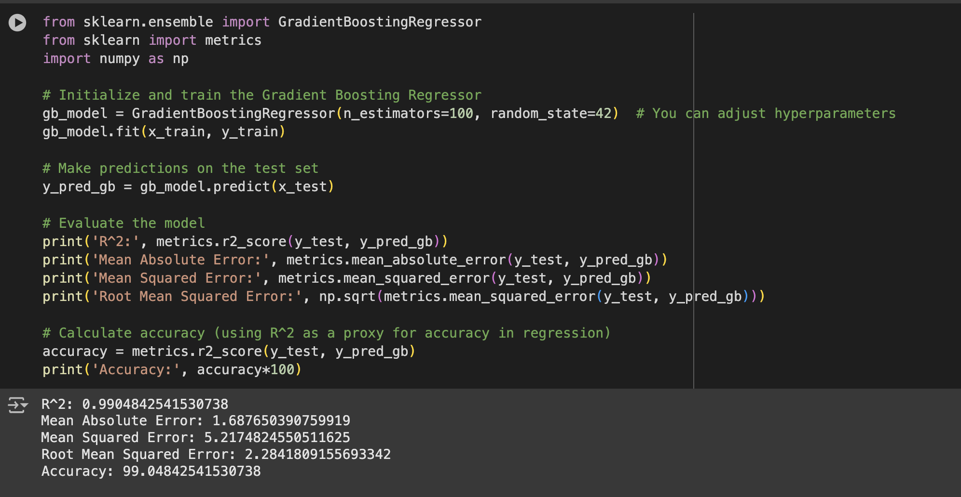
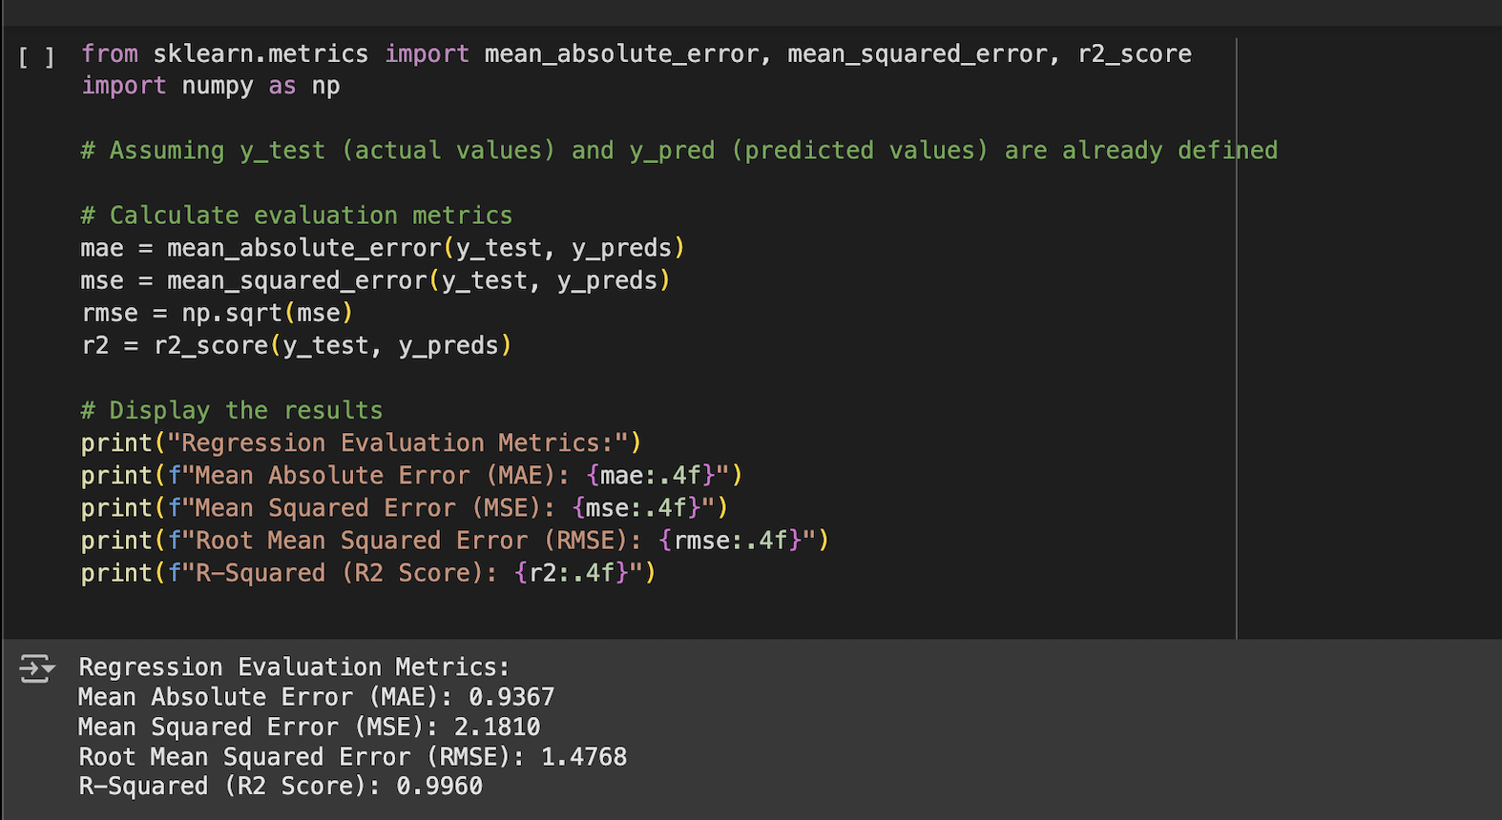
This code snippet uses the Gradient Boosting Regressor algorithm from the sklearn library to predict gold prices. It trains the model on historical data (x_train, y_train), makes predictions on a test set (x_test), and then evaluates the model's accuracy using metrics like R-squared, Mean Absolute Error, Mean Squared Error, and Root Mean Squared Error to understand its performance and how well it predicts gold prices.
This part of the code takes the actual gold prices (y_test) and the model's predictions (y_preds) and calculates several metrics (MAE, MSE, RMSE, R2) to assess how well the model is performing. These metrics help to understand the accuracy and reliability of the gold price predictions.

Slide 10
Conclusion
Summary:
This case study aimed to develop a predictive model for gold prices using machine learning. Two algorithms, Random Forest and Gradient Boosting, were trained and evaluated on historical gold price data. The Random Forest Regressor model outperformed Gradient Boosting, achieving high accuracy on both training (99.94%) and testing (99.04%) datasets. This indicates the model's ability to effectively capture the relationships between gold prices and other financial indicators.
Its high R-squared value of 0.9960 on the test data further validates its effectiveness in explaining the variance in gold prices. This model can potentially assist investors and businesses in making informed decisions related to gold investments and risk management.
Future Work:
Generative AI: Explore the use of generative AI techniques, like generative adversarial networks (GANs), to generate synthetic data for augmenting the training dataset and improving the model's generalization capabilities, especially in scenarios with limited data availability.
Deep Learning: Investigate the potential of deep learning models, such as recurrent neural networks (RNNs) or long short-term memory (LSTM) networks, for capturing complex temporal dependencies in gold price data and potentially improving prediction accuracy.
Real-time Data: Integrate real-time data feeds and update the model periodically to reflect current market conditions and ensure the model's continued relevance.

Slide 11
References
https://www.kaggle.com/datasets/altruistdelhite04/gold-price-data
https://github.com/Chinu1712/AIGREENSKILLS/tree/main/Case_Study
https://github.com/Shreyas521032/Green_Skill_Workshop/tree/main/Case%20Study-Gold%20Price%20Prediction
https://github.com/Ruthvek1/edunet-workshop-/tree/main/Case_Study

Slide 12
Thank You
Notes:
Thank You !!

